Slide 1
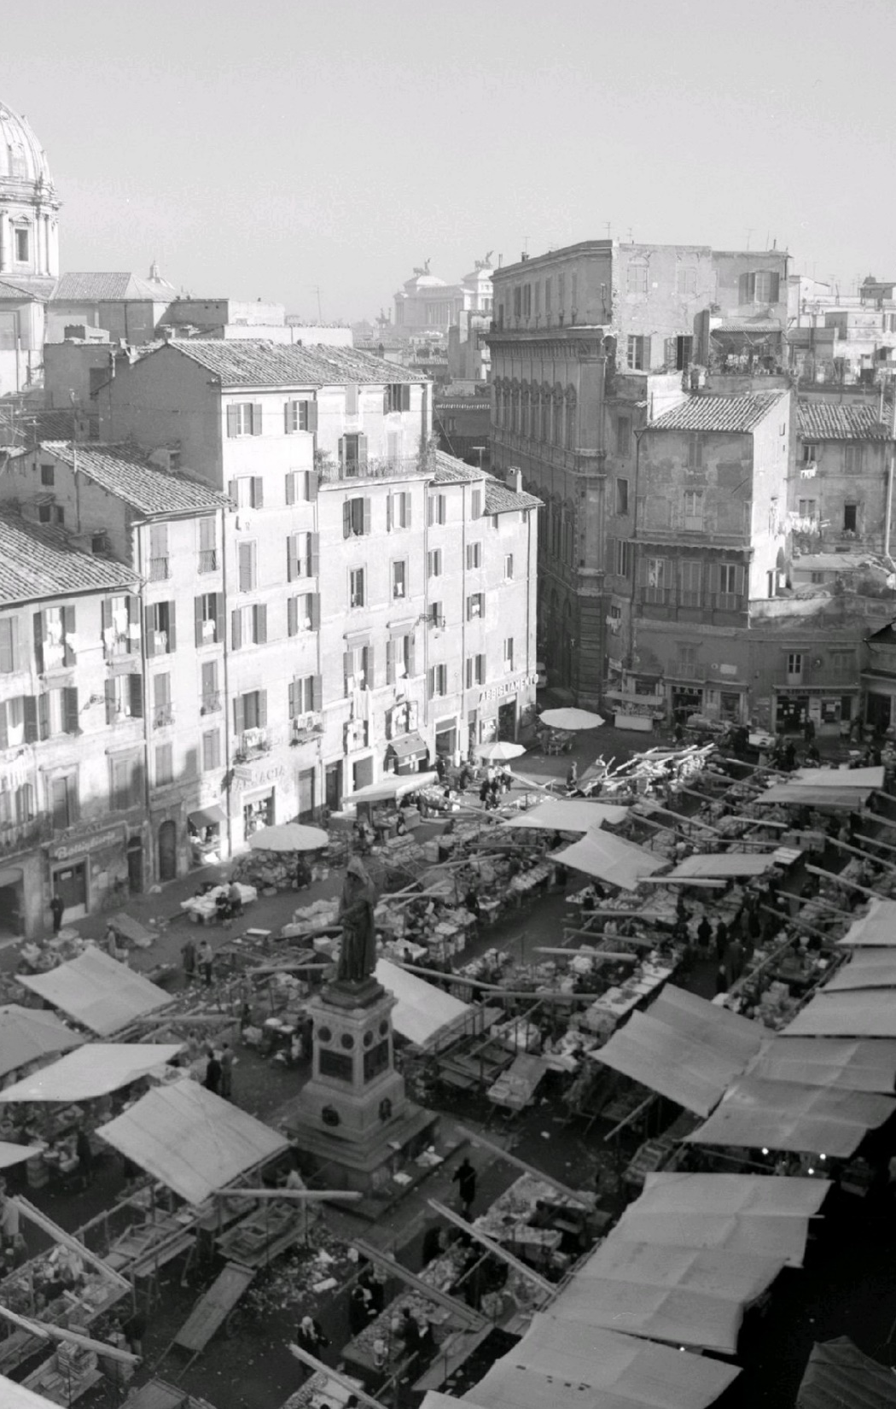
GeoMapping for InfoSystems
Procedures for geographical aggregation of textual and graphical resources from public and institutional info systems
Dr. Klaus E. Werner
Digital Library
2022 Oct 27

Slide 2
Intro
We describe a highly automatized procedure for the geographical aggregation of textual and graphical resources taken from public and institutional information systems. The system can be used as part of GraphDB systems but will mostly be configured with a graphical UI.
In the latter case, a vector layer with polygons or multipoints for all relevant objects will provide the basis. Modern or historical maps can provide optional backgrounds.
To connect and query external information services data we use their publicly exposed APIs. Textual string queries are notoriously messy (false positives, false negatives) so we mostly demonstrate the use of IDs (GND, VIAF, Wikidata).
A short discussion about the interoperability of data will conclude the session.
keywords: OSM, Wikidata, GND, VIAF, GeoJSON, SPARQL

Slide 3
WikiData

Slide 4
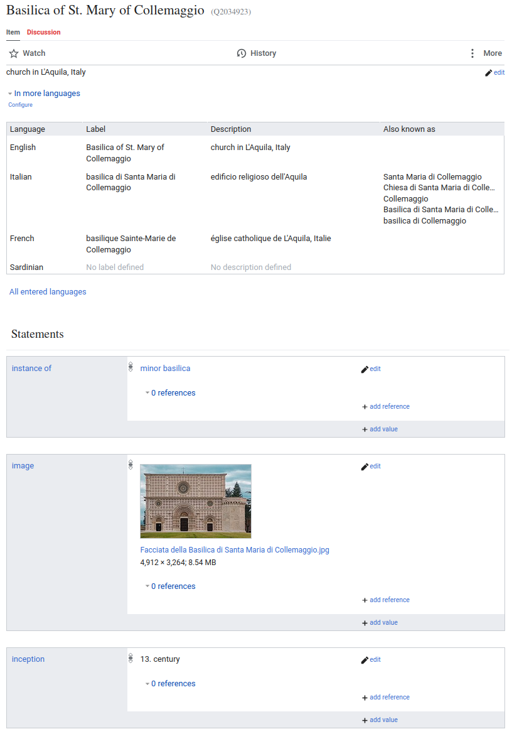
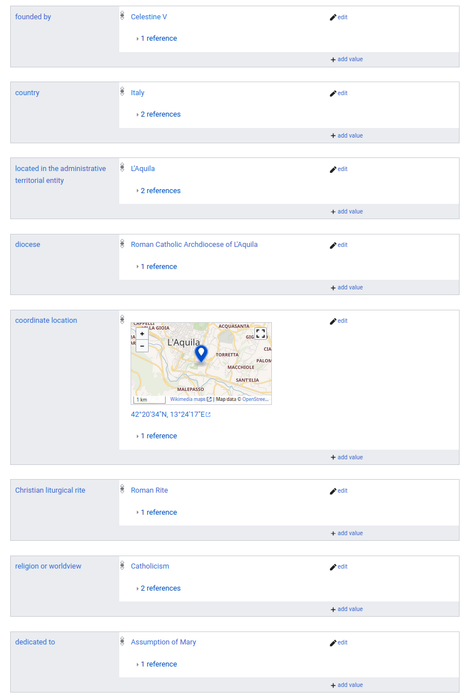
WikiData Information

Slide 5
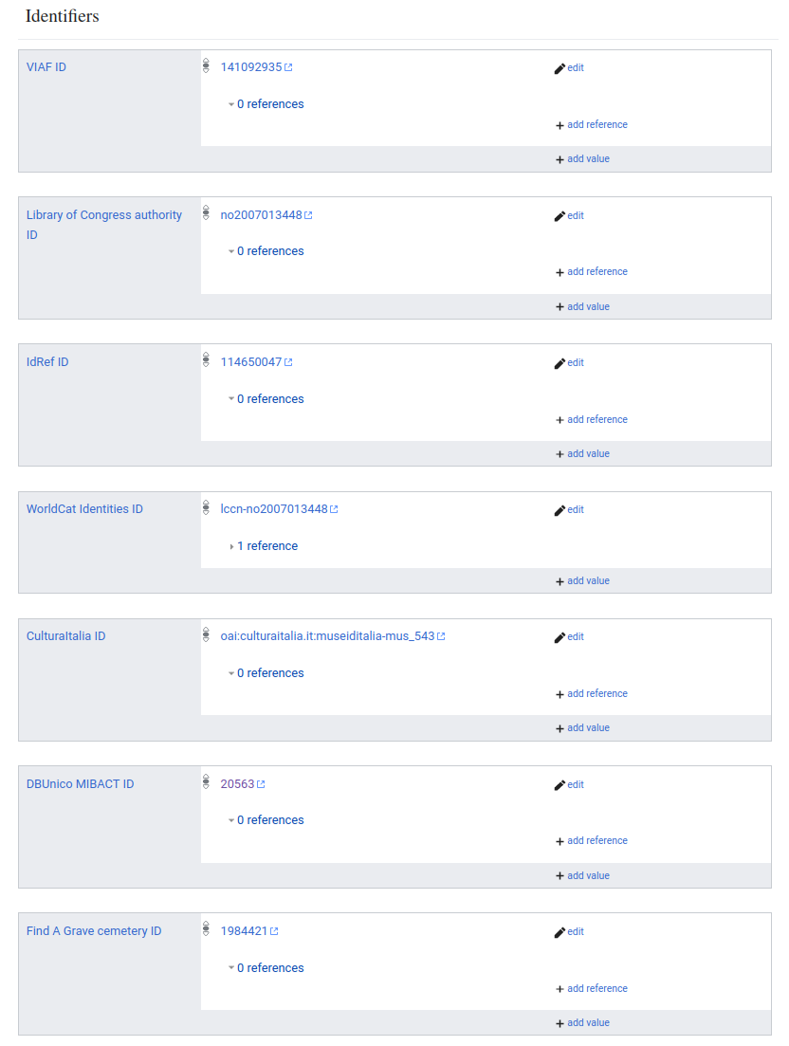
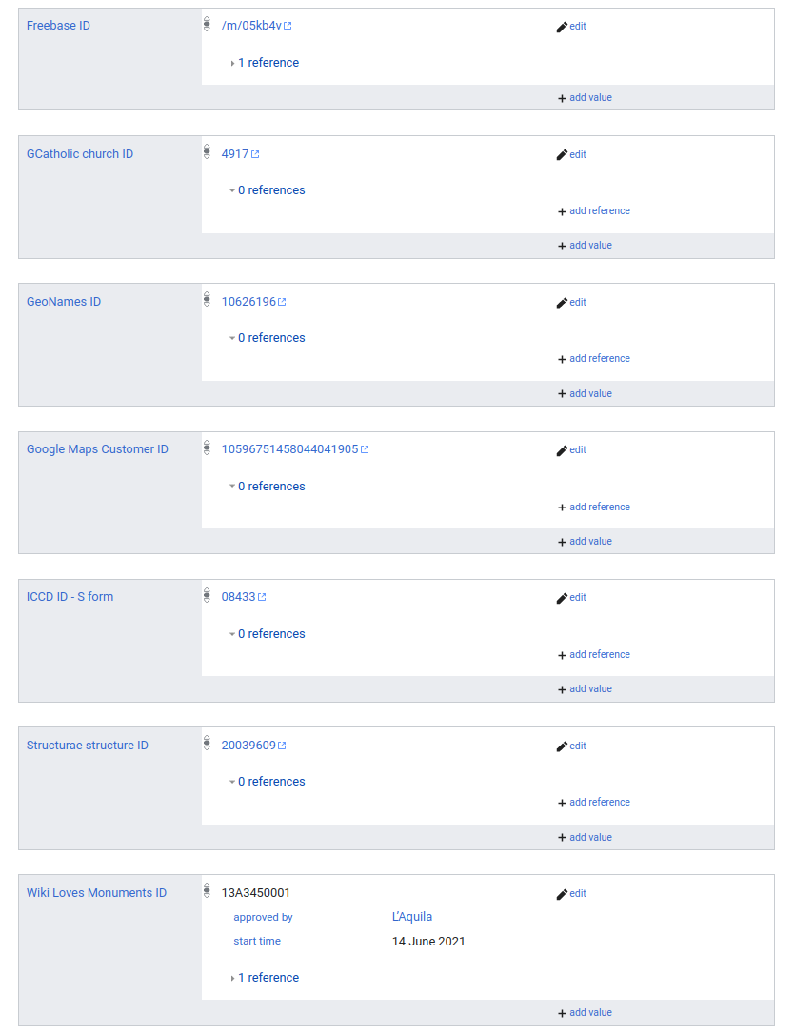
WikiData Information

Slide 6
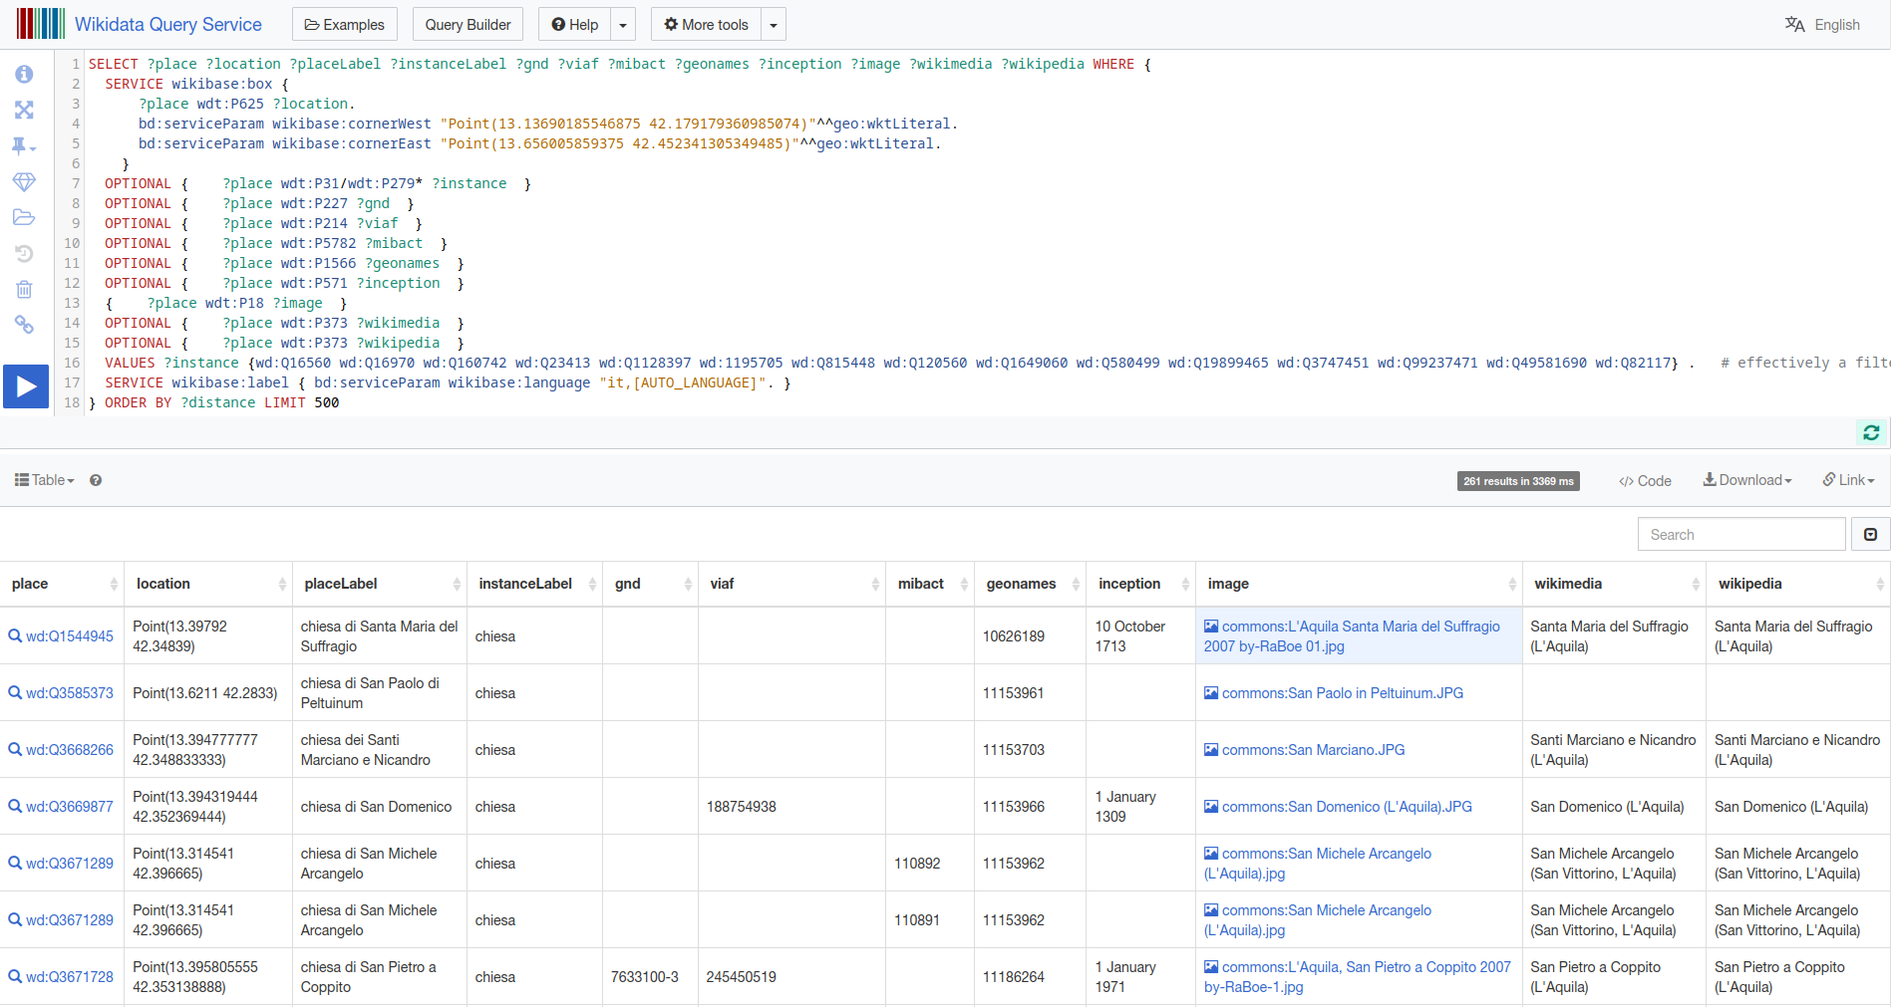
WikiData SPARQL on https://query.wikidata.org/

Slide 7
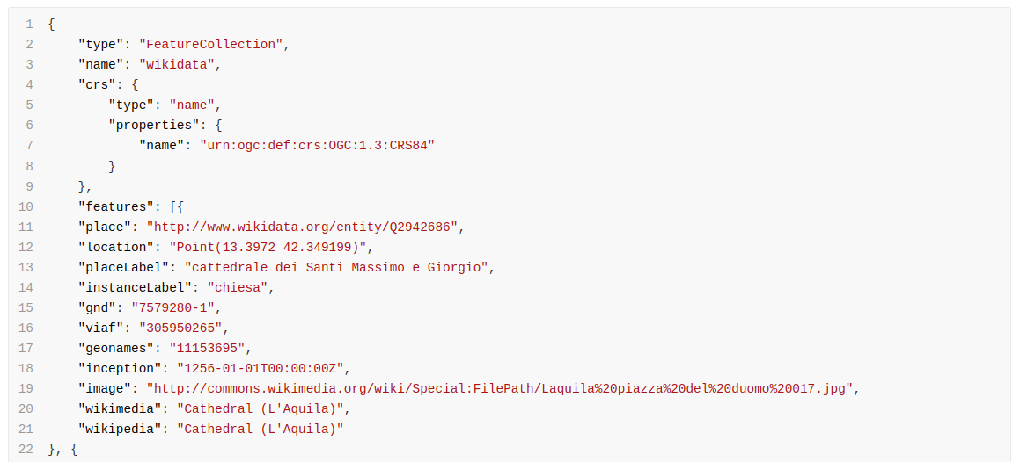
WikiData SPARQL Result
←--- WikiData ID
←--- wikiData ID
←--- GND ID
←--- GND ID

Slide 8
OpenStreetMap (OSM) Data

Slide 9
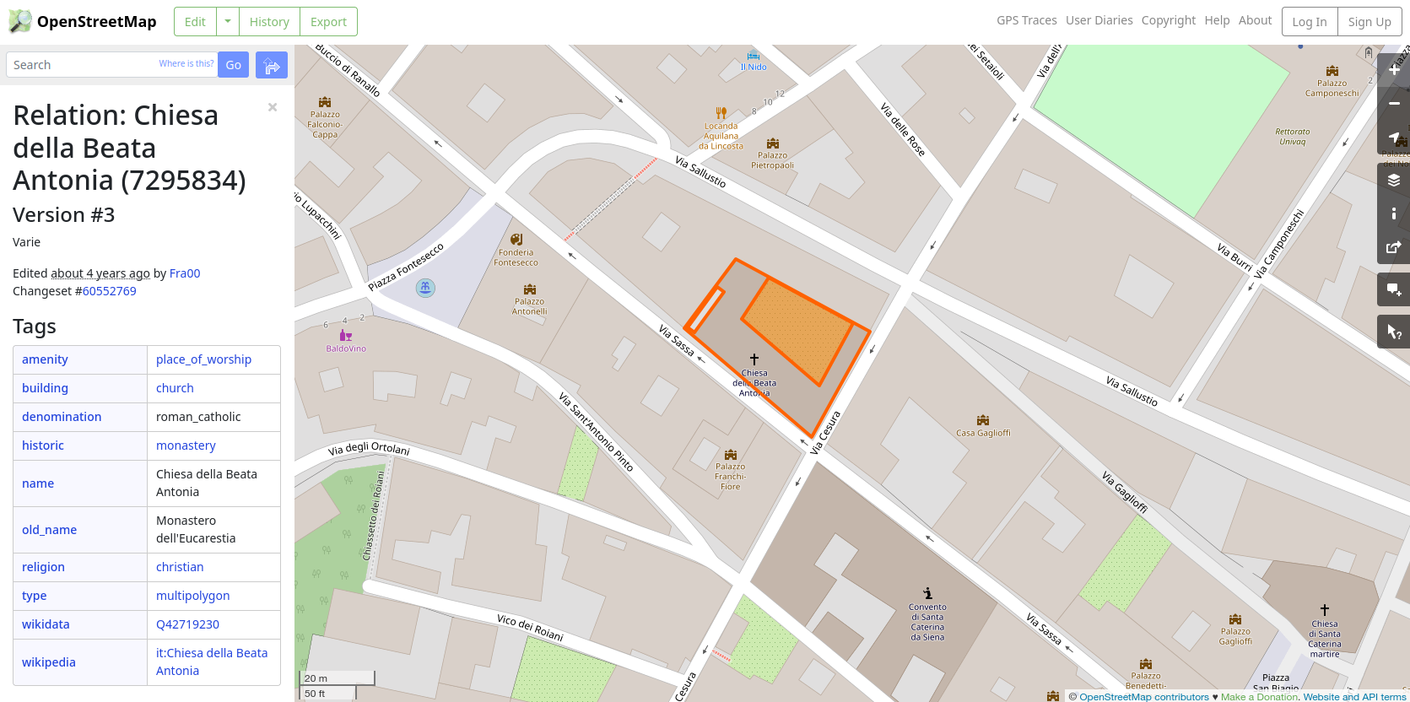
OSM Information

Slide 10
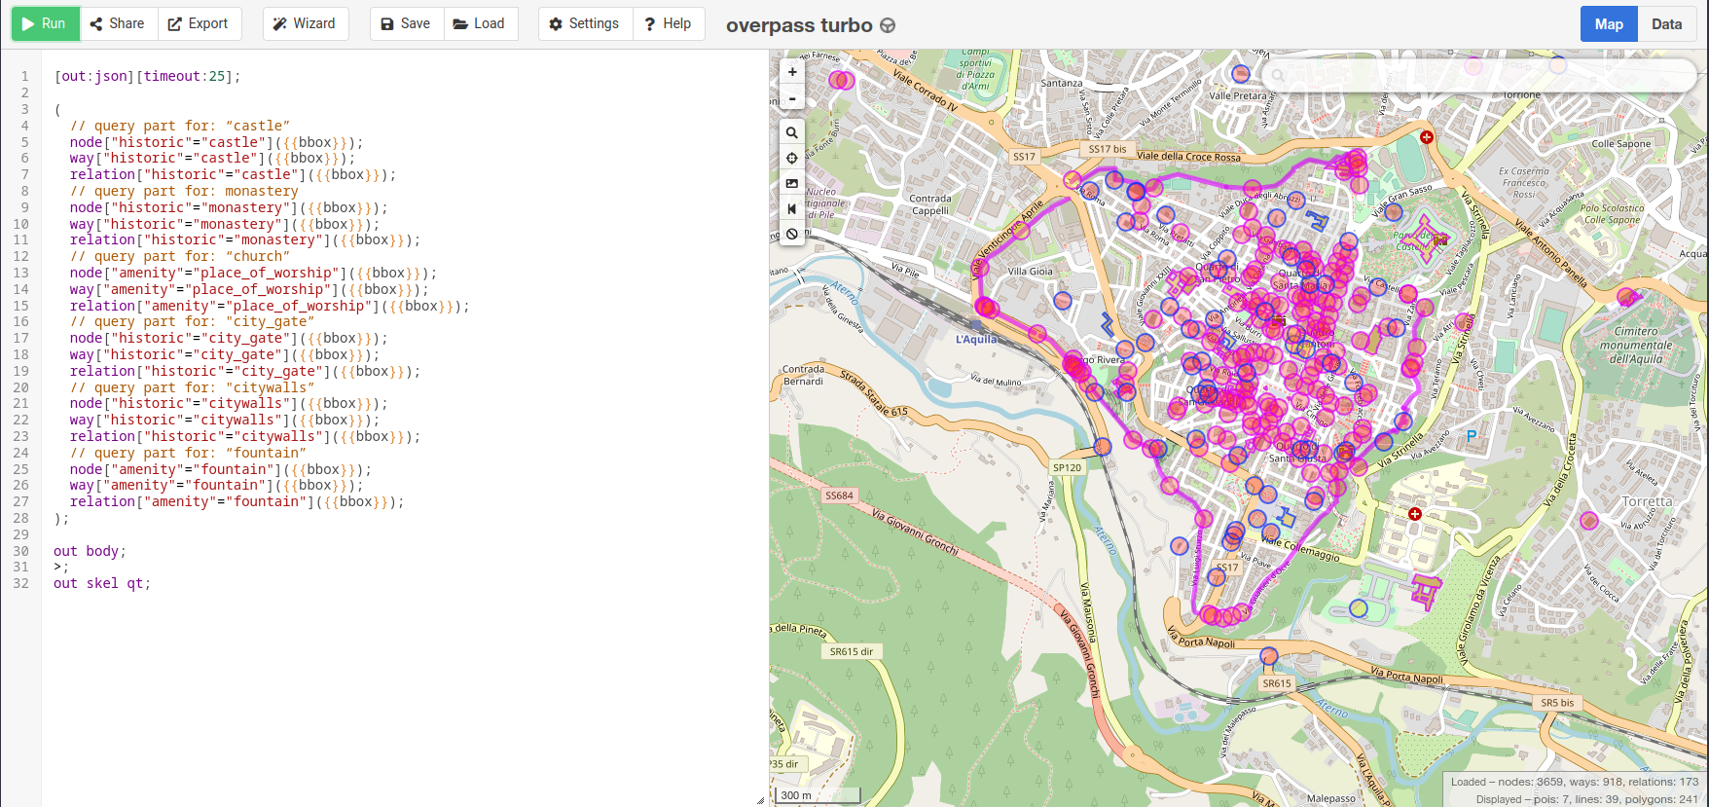
OSM Query on overpassturbo

Slide 11
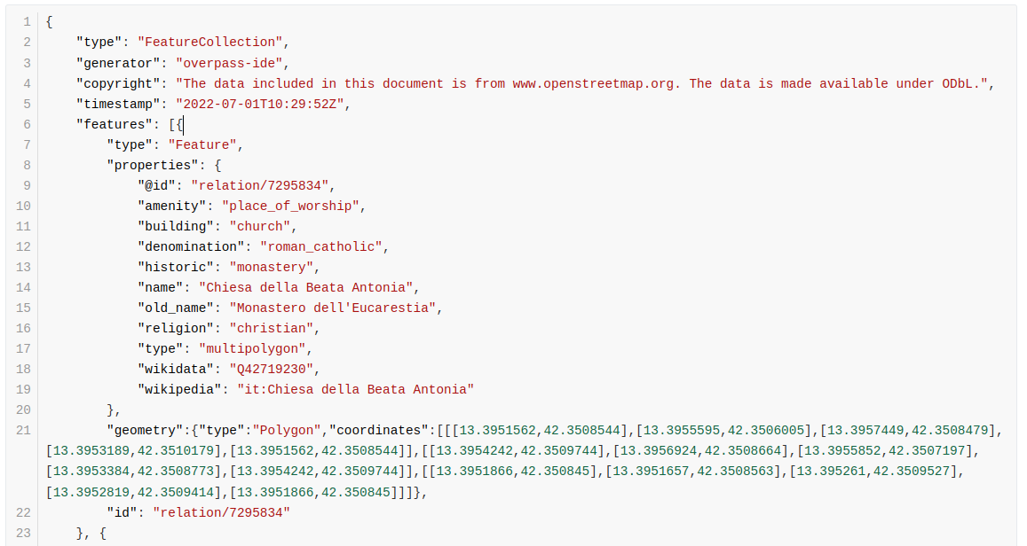
OSM Query Result
←-- OSM ID
←--- wikiData ID

Slide 12
Combining the Data

Slide 13
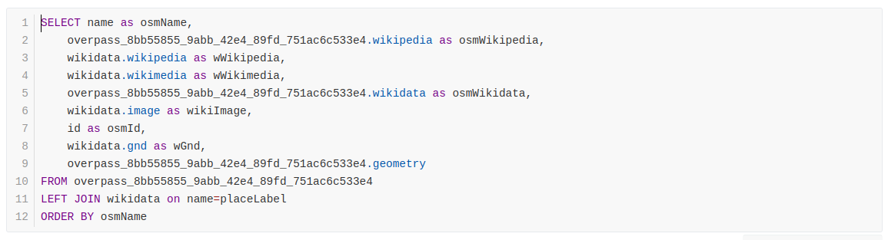
Combining the Data SQL Query in QGIS
Combine WikiData and OSM Data in QGIS:

Slide 14
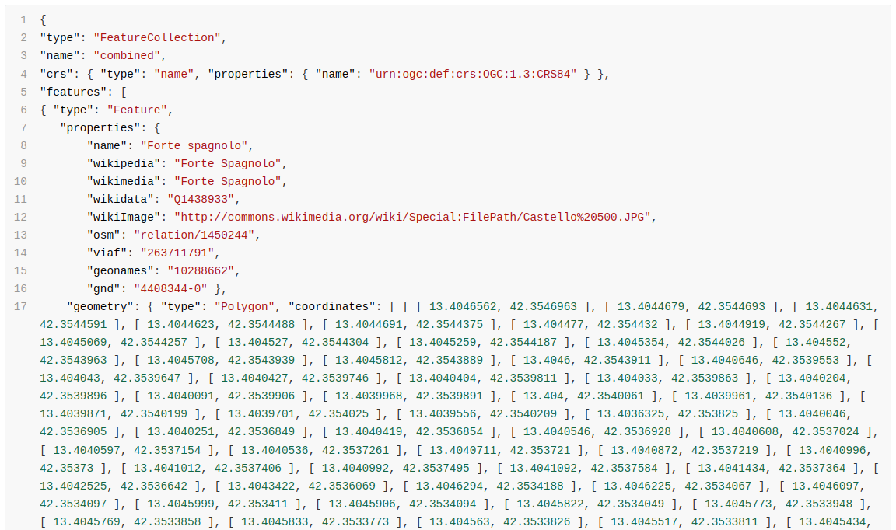
Combining the Data Final GeoJSON

Slide 15
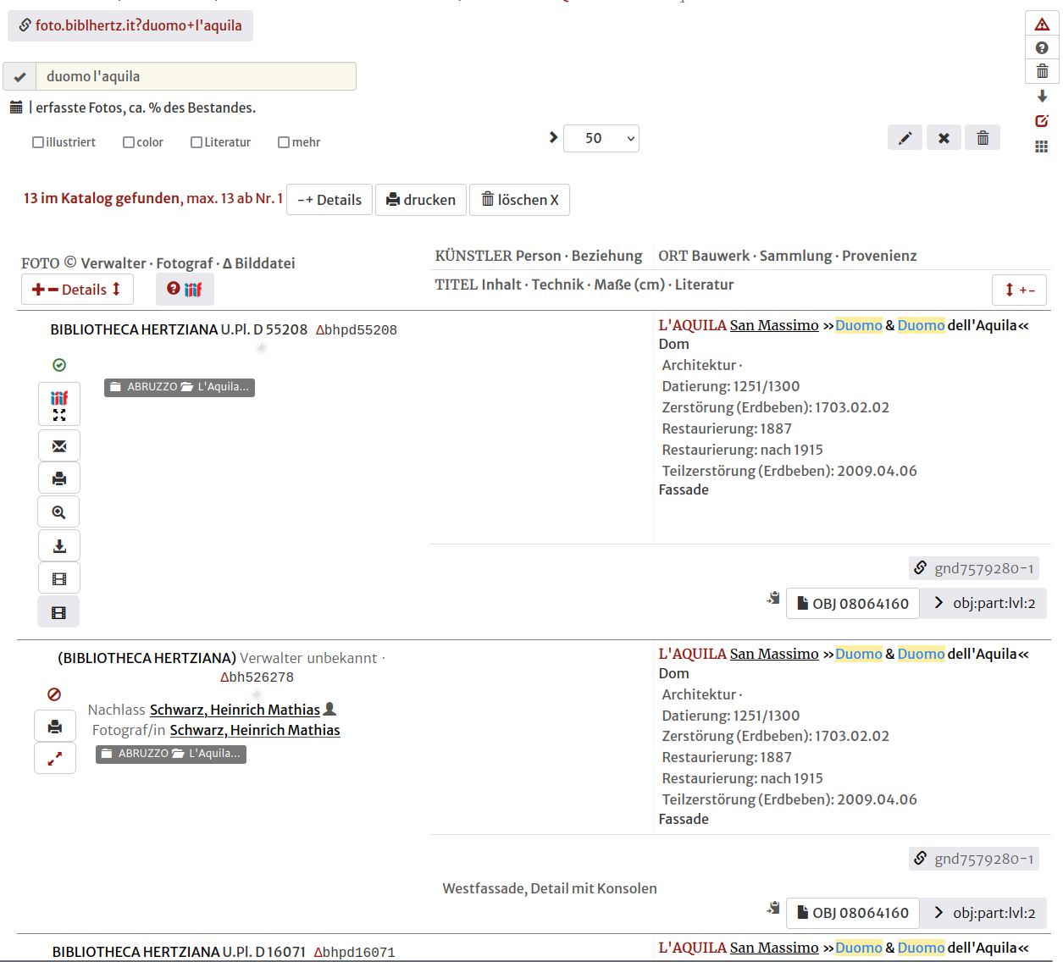
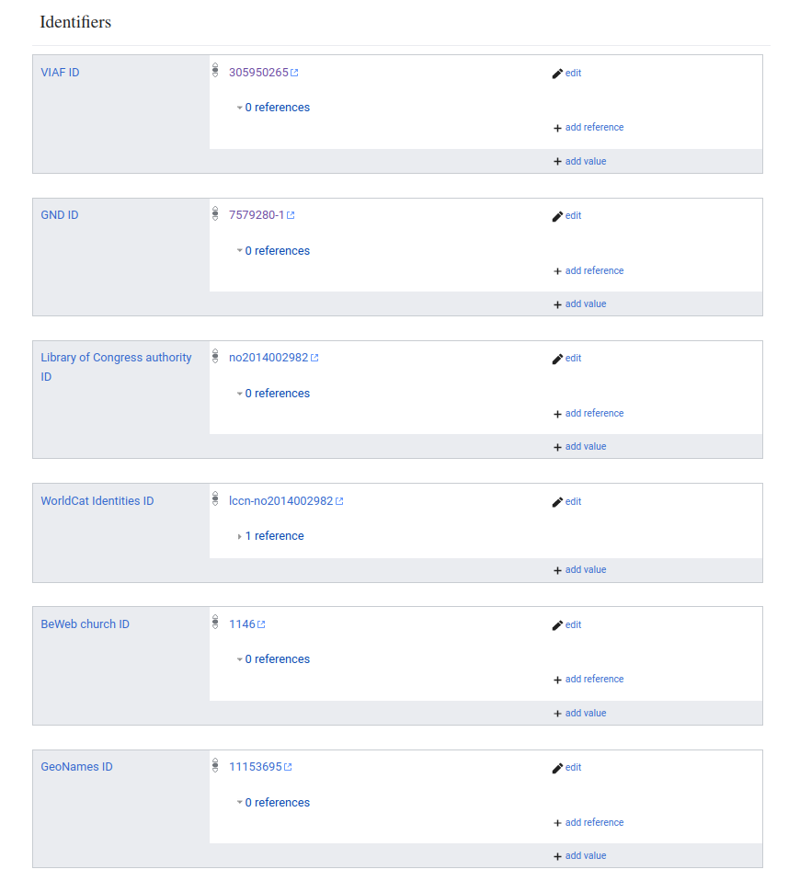
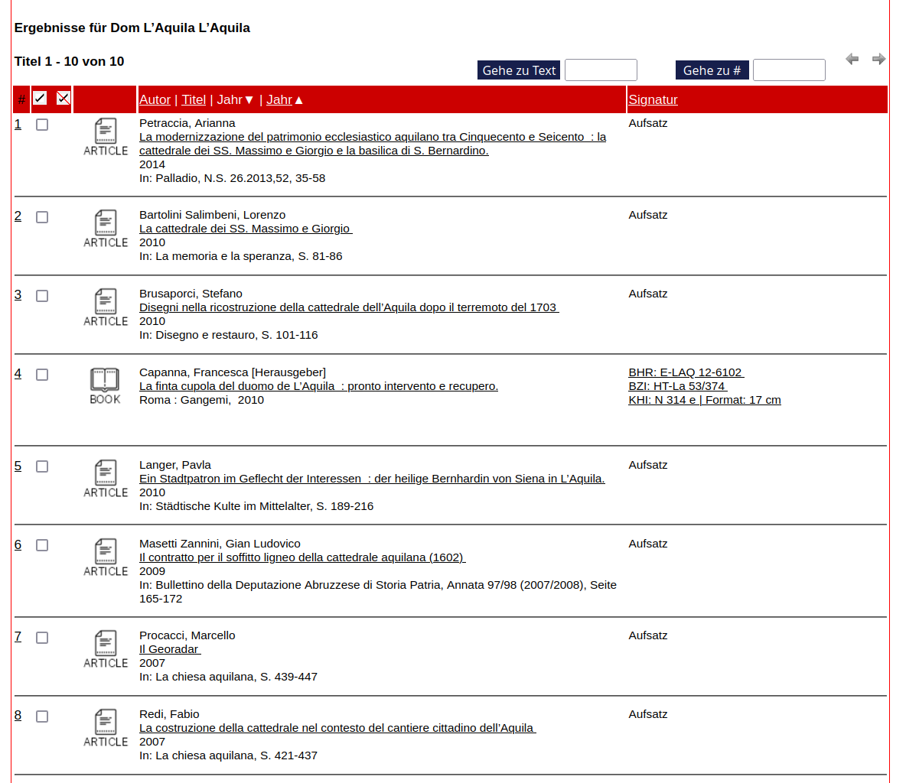
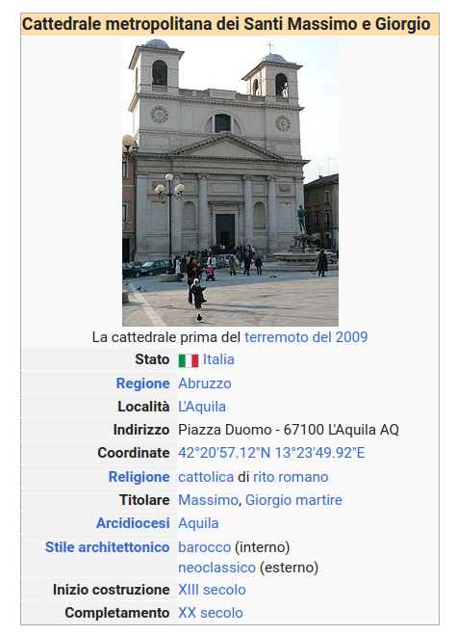
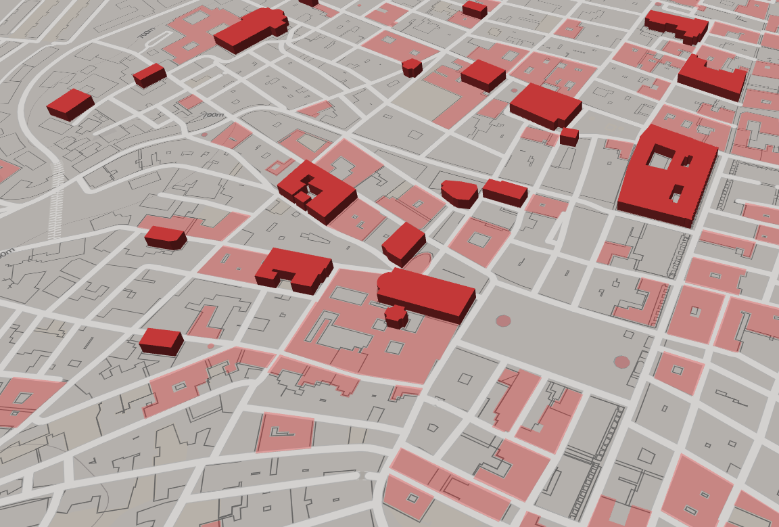
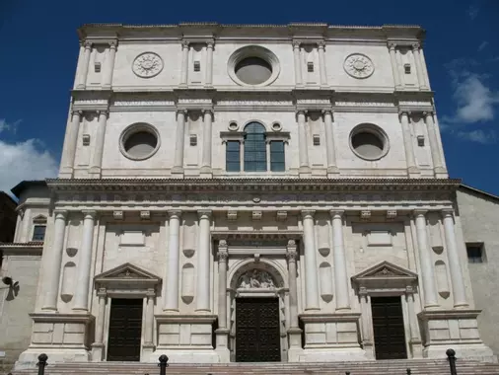
Resources and IDs
VIAF
Ground Data Providers
Queriable Services
BHMPI
Fototeca
GND
WikiData
BHMPI
Biblioteca
ICCD
WDT
Wikipedia
WikiMedia
OSM
OpenStreetMap

Slide 16
Data Provided by WikiData
*wikidata "Q3889420"
location
placeLabel
instanceLabel
instance
*gnd
*viaf
*worldcat
oclc {?}
getty {?}
*dare
*arachne
*iccd
*mibact
*geonames
inception
image
*wikimedia
*wikipedia
geometry(Point)

Slide 17
Data Provided by OpenStreetMap
*id "relation/10172672"
alt_name
building
castle_type
historic
name
old_name
*wikidata "Q3889420"
*wikipedia" "it:Palazzetto dei Nobili"
geometry (Polygon)

Slide 18
Data provided by ICCD
rdfs:label
*core:localIdentifier
rdf:type
rdfs:seeAlso
*wikidata
a-cd:hasBibliography "Il viaggio in Italia di Giovanni Gargiolli. Le origini del Gabinetto Fotografico Nazionale 1895 – 1913, a cura di C.Marsicola, Roma 2014"
a-cd:hasRelatedWorkSituation
a-cd:hasResponsibility
a-cd:hasSubject
a-cd:isMemberOfCollection
core:hasCategory
a-dd:hasAffixedElement
a-dd:hasCulturalPropertyType
core:hasAuthor "Gargiolli, Giovanni"
cis:isMemberOfColCultEnt
a-dd:hasDating

Slide 19
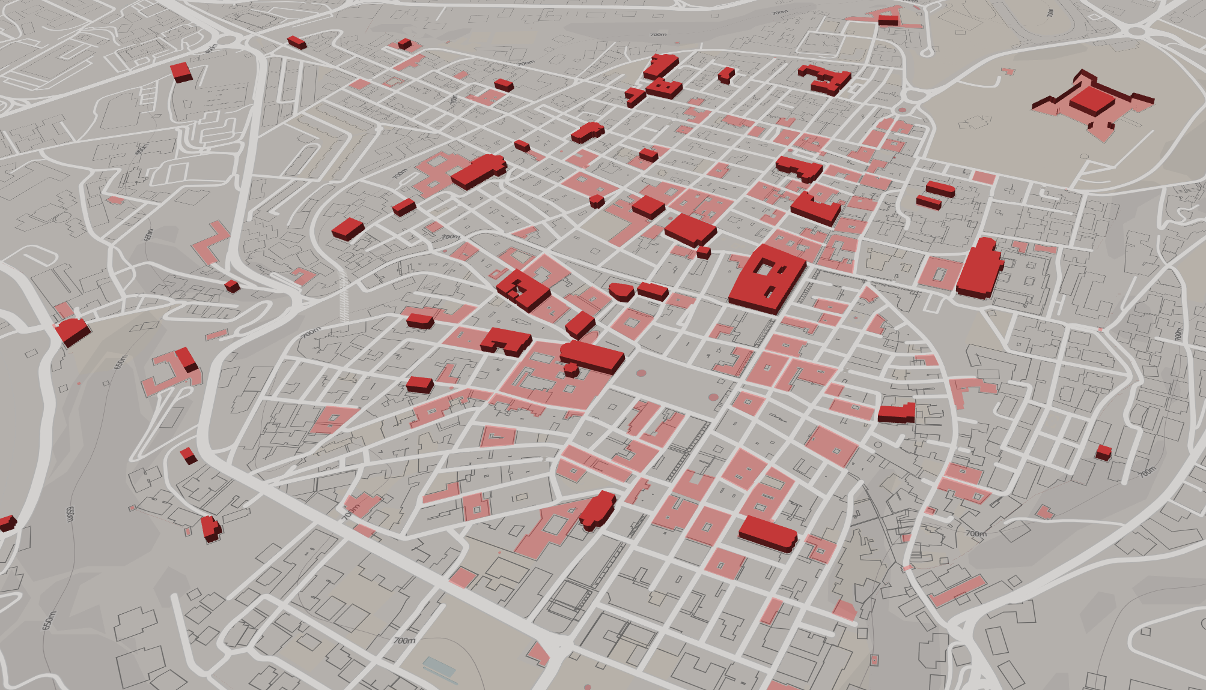
OSM Rendering on MapBox

